Slide 1
Control Engineering
Lecture 8

Slide 2
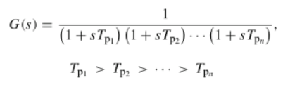


Quasi-optimum design methods
Industrial processes form:
Approximated as

Slide 3
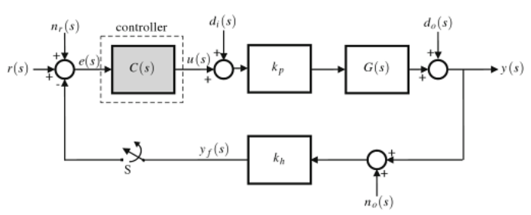
Quasi-optimum design methods

Slide 4

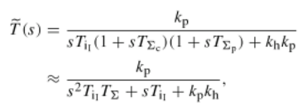

Optimum magnitude
Applying integral action to have zero steady state position error:
and the closed loop

Slide 5



Optimum magnitude
The design criteria:
The condition is satisfied if:
Resulting

Slide 6


Optimum magnitude
In this case
which is close to unity in the low frequency region
The form of the closed loop:

Slide 7
Optimum magnitude
Which are the performances of the method?
Hint: the closed loop is a second order transfer function, the already developed equations can be used

Slide 8
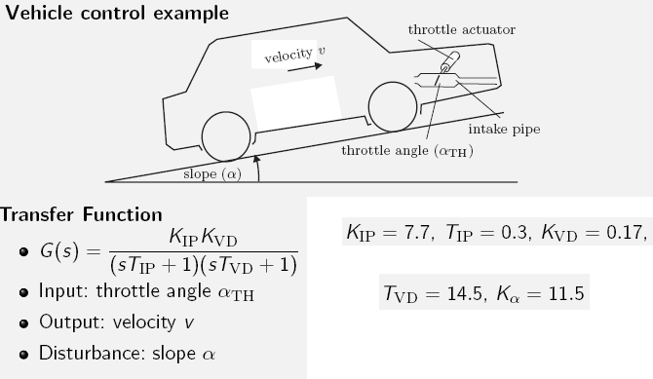
Example

Slide 9
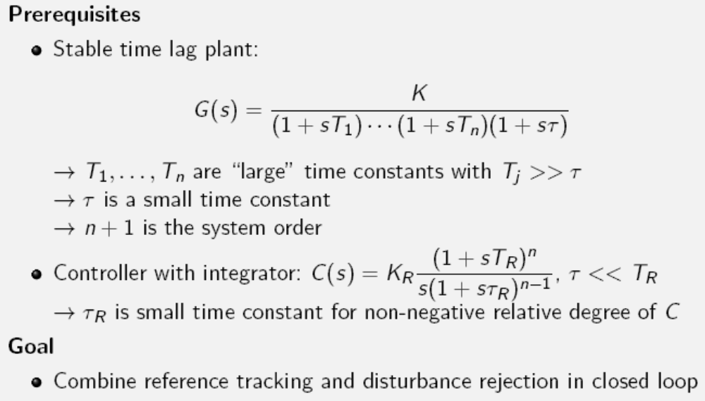
Symmetrical optimum

Slide 10

Symmetrical optimum
‘The crossover frequency of the compensated system is ω_{cr} = 1/(2T∑) and the PI(D) is adjusted such that a region with a slope of -20 dB/dec is secured for one octave on the right and m octaves on the left of the crossover frequency”
The Kessler’s form of the open loop

Slide 11
Symmetrical optimum
Which are the performances of the method?
Plot the Bode diagram of the open loop
Design a controller with this method for the previous example. Compare the two results

